Slide 1

Course code and name: 2hsoe53 – Organizational behaviour
Topic name: Values and Attitudes
Prepared by:
19bce028 – bhut bhavya
19bce091 – Kalyani dev
19bce096 – khant aum
19bce161 – patel ashray
19bce248 – shah dhruvil

Slide 2


Table Of Contents Of Values
Values v/s Attitude
What is Value?
Characteristics of Value
Types of Values
Importance of Values
Sources of Values
Values and Beliefs
Values in Workplace

Slide 3
Values v/s Attitude
Values
Attitude
Values help to guide our behavior.
Values are more or less permanent in nature.
They derived from social and cultural mores.
Values decide what we think as for right, wrong, good, or unjust.
Attitudes are the response that is a result of our values.
Attitudes are changeable with favorable experiences.
These are personal experiences.
Attitudes are our likes and dislike of things, people, and objects.

Slide 4
What is Values?
Values defined in Organizational Behavior as the collective conceptions of what is considered good, desirable, and proper or bad, undesirable, and improper in a culture.
In simple terms values are the principles that help you to decide what is right and wrong, and how to act in various situations:
A value is a shared idea about how something is ranked in terms of desirability, worth or goodness. Sometimes, it has been interpreted to mean “such standards by means of which the ends of action are selected”.

Slide 5
According to R.K. Mukherjee, “Values are socially approved desires and goals that are internalized through the process of conditioning, learning or socialization and that become subjective preferences, standards, and aspirations”.
“Values are like fingerprints. Nobody’s are the same, but you leave them all over everything you do.”
~ Elvis Presley

Slide 6
Characteristics of Value
These are extremely practical, and valuation requires not just techniques but also an understanding of the strategic context.
These can provide standards of competence and morality.
Most of our core values are learned early in life from family, friends, neighborhood school, the mass print, visual media and other sources within the society.
Values can differ from culture to culture and even person to person.
They build up societies, integrate social relations.

Slide 7
Contd.
They contain a judgmental element in that they carry an individual’s ideas as to what is right, good, or desirable.
They mold the ideal dimensions of personality and depth of culture.
They influence people’s behavior and serve as criteria for evaluating the actions of others.
They have a great role to play in the conduct of social life. They help in creating norms to guide day-to-day behavior.

Slide 8
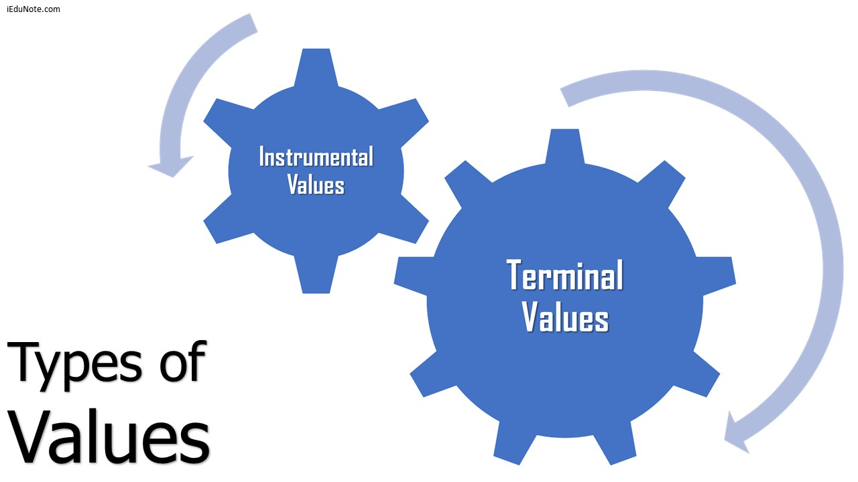
Types of Values

Slide 9
Terminal Values
These are values that we think are most important or most desirable.
These refer to desirable end-states of existence, the goals a person would like to achieve during his or her lifetime.
They include happiness, self-respect, recognition, inner harmony, leading a prosperous life, and professional excellence.

Slide 10
Fun Activity
Whom do you admire? List three of that person’s admirable qualities.
Describe an incident or event from which you learned a lesson “the hard way.”
What could you change about yourself to become a better person?
What three qualities do you value in a friend? A teacher? A parent?
Who has been most important in your life in helping you establish your values? Please explain.
What are the three most important values you think it will be important to encourage in your children one day?
What is the one rule that you believe is important to live your life by?
If we lived in a perfect world, how would people behave differently than they do now?

Slide 11
Instrumental Values
Instrumental values deal with views on acceptable modes of conductor means of achieving the terminal values.
These include being honest, sincere, ethical, and being ambitious. These values are more focused on personality traits and character.
There are many typologies of values. One of the most established surveys to assess individual values is the Rokeach Value Survey.
Examples of Instrumental Values are Ambitious (hardworking),Broadminded (open-minded),Capable (competent, efficient),Cheerful ( lighthearted, joyful) etc..

Slide 12
Importance of Values
Values are the enduring beliefs that a specific mode of conduct or end-state of existence is personally or socially preferable.
As ethical conduct receives more visibility in the workplace, the importance of values is increased as a topic of discussion in management.
Values are general principles to regulate our day-to-day behavior. They not only give direction to our behavior but are also ideals and objectives in themselves.
They are the expression of the ultimate ends, goals or purposes of social action.

Slide 13
Pioneer sociologist Durkheim emphasized the importance of values (though he used the term ‘morals’) in controlling disruptive individual passions.
E. Shils also makes the same point and calls ‘the central value system,’ (the main values of society) are seen as essential in creating conformity and order.
Indian sociologist R.K. Mukherjee writes: “By their nature, all human relations and behavior are embedded in values".

Slide 14
Sources of Values
Family: Family is a great source of values. A child leams his first value from his family.
Friends & peers: Friends and peers play a vital role in achieving values.
Community or society: As a part of society, a person leams values from society or different groups of society.
School: As a learner, school and teachers also play a very important role in introducing values.
Media: Media such as – Print media, Electronic media also play the role of increasing values in the mind of people.
Organization: Different organizations and institutions also play a vital role in creating value.
Books

Slide 15


Slide 16
Values And Beliefs
Values:-
Values provide standards of competence and morality.
These are ideas that we hold to be important.
They govern the way we behave, communicate and interact with others.
They transcend specific objects, Situations or persons.
These are relatively permanent and there is resistant to change them.
Beliefs:-
Beliefs are concepts that we hold to be true.
These may come from religion, but not always.
Beliefs determine our attitudes and opinions.

Slide 17


Slide 18
Values in Workplace
Values can strongly influence employee conduct in the workplace. If an employee values honesty, hard work, and discipline, for example, he will likely make an effort to exhibit those traits in the workplace.
This person may, therefore, be a more efficient employee and a more positive role model to others than an employee with opposite values.
Conflict may arise, however, if an employee realizes that his co-workers do not share his values.
For example, an employee who values hard work may dislike co-workers who are lazy or unproductive without being reprimanded.
Even so, additional conflicts can result if the employee attempts to force his own values on his co-workers.

Slide 19
Table Of Contents of Attitudes
Introduction
Types of Attitudes
Functions of Attitudes
Components of Attitudes
Characteristics of Attitudes
Importance of Attitudes

Slide 20
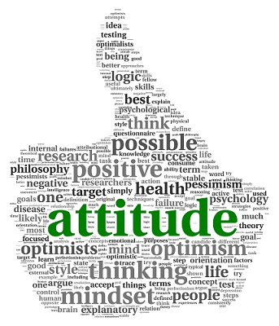
Introduction
Attitudes are evaluative statements indicating one’s feeling either favourably or unfavourably towards persons, objects, events or situations. ~Robbins
Attitude is a tendency or predisposition to evaluate an object or symbol of that object in a certain way. ~Daniel Katz
Attitude is an enduring organization of motivational, emotional, perceptual and cognitive processes with respect to some aspect of the individual’s world. ~Krech S. Crutchfield

Slide 21


Slide 22
Job Satisfaction
Job satisfaction is the level of fulfillment a person feels regarding his or her job.
A person with a high level of job satisfaction holds positive attitudes about the job, while a person who is dissatisfied with his or her job holds a negative attitude about the job.
A person having a negative attitude shows a personality disposition that is inclined to experience nervousness, tension, upset, distress, etc. whereas those with a positive attitude will feel happy themselves, others and their work.
When people speak of employee attitudes, more often than not they mean job satisfaction. In fact, the two are frequently used interchangeably.

Slide 23
Job Involvement
Job involvement refers to the degree with which an individual identifies psychologically with his or her job and perceives his or her perceived performance level important to self-worth.
High levels of job involvement are related to fewer absences and lower resignation rates.
High level of Job involvement of the employees will please his or her higher authorities and make the Organization a better workplace.
Job involvement enhances individuals’ work performance by motivating them to put extra endeavour and use their creativity skills to solve problems and work intelligently.

Slide 24
Organizational Commitment
Organizational Commitment is understood as one’s identification with his or her organization and feels proud of being its employee.
Different studies demonstrate that an individual’s level of organizational commitment is a better indicator of turnover than the far more frequently used job satisfaction predictor, explaining as much as 34 percent of the variance.
Organizational commitment refers to the connection or bond employees shares with their employer (the organization).

Slide 25
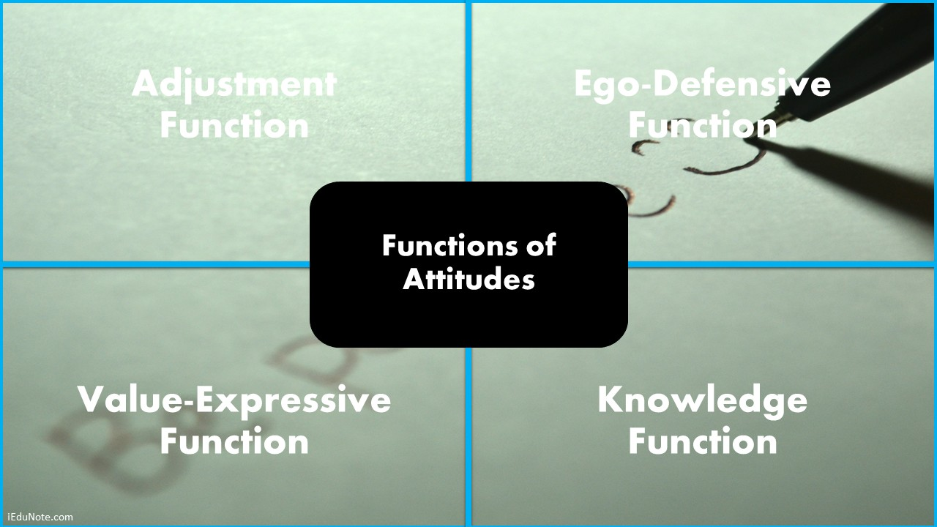

Slide 26
Adjustment Function
Attitudes often help people to adjust to their work environment and are the basis for the future behavior of the employees.
The adjustment function directs people toward pleasurable or rewarding objects and away from unpleasant, undesirable ones.
It serves the utilitarian concept of maximizing reward and minimizing punishment.
Example: Well-treated employees tend to develop a positive attitude towards their management or job.

Slide 27
Ego-Defensive Function
The ego-defensive function refers to holding attitudes that protect our self-esteem or that justify actions that make us feel guilty.
This function involves psychoanalytic principles where people use defense mechanisms to protect themselves from psychological harm.
For example; an older manager whose decisions are continually challenged by a younger subordinate manager may feel that the latter is immature and inexperienced.
In truth, the younger subordinate may be right in challenging the decisions.
On the other hand, the older manager is not going to admit this but will try to protect the ego by blaming the other party.

Slide 28
Value-Expressive Function
Value-expressive attitudes enable the expression of the person’s centrally held values.
Some attitudes are important to a person because they express values that are integral to that person’s self-concept.
Self-concept is the ability to reflect on one's own traits, skills and behavior.
Example: A manager who values honest and sincere work will be more vocal against an employee who is having a very casual approach towards work.

Slide 29
Knowledge Function
The knowledge function refers to our need which is consistent and relatively stable.
This allows us to predict what is likely to happen, and so gives us a sense of control.
Knowing a person’s attitude helps us predict their behavior.
In the absence of knowledge about a person, we may use a stereotyped attitude for judging the person.
For example: People who are not familiar with nuclear energy may develop an attitude that is dangerous and should not be used as an energy source.

Slide 30
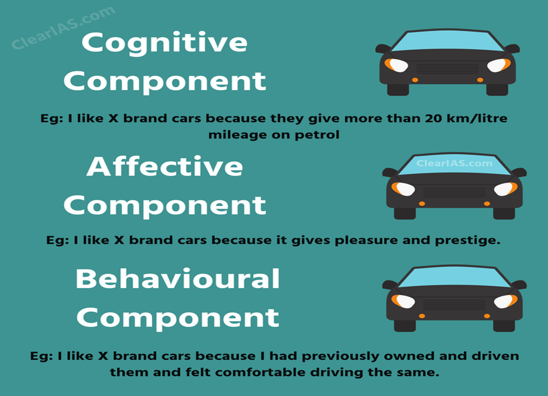
Components of Attitude

Slide 31
Cognitive Component
The cognitive component of attitudes refers to the beliefs, thoughts, opinions, and attributes that we would associate with an object.
It refers to that part of attitude which is related in general knowledge of a person.
Cognitive component of attitude is associated with the value statement.
Typically these come to light in generalities or stereotypes, such as ‘all babies are cute’, ‘smoking is harmful to health’ etc.

Slide 32
Affective Component
Affective component is the emotional or feeling segment of an attitude.
It is related to the statement which affects another person.
It deals with feelings or emotions that are brought to the surface about something, such as fear or hate.
It is an expression of feelings about a person, object or a situation.
Using the above example, someone might have the attitude that they love all babies because they are cute or that they hate smoking because it is harmful to health.

Slide 33
Behavioural Component
Behaviour component of an attitude consists of a person’s tendencies to behave in a particular way toward an object.
It refers to that part of attitude which reflects the intention of a person in the short-run or long run.
Using the above example, the behavioral attitude maybe- ‘I cannot wait to play with the baby’, or ‘we better keep those smokers out of the library, etc.

Slide 34
Characteristics Of Attitude
Attitudes are the complex combination of things we call personality, beliefs, values, behaviors, and motivations.
All people, irrespective of their status or intelligence, hold attitudes.
Attitude helps to define our identity, guide our actions, and influence how we judge people.
Attitude helps us define how we see situations and define how we behave toward the situation or object.
It can also be explicit and implicit. Explicit attitude is those that we are consciously aware of an implicit attitude is unconscious, but still, affect our behaviors.

Slide 35
Contd.
An attitude is a summary of a person’s experience; thus, an attitude is grounded in direct experience predicts future behavior more accurately.
It may be positive or negative and may be affected by age, position, and education.
An attitude is a point of view, substantiated or otherwise, true or false, which one holds towards an idea, object, or person.
It includes certain aspects of personality as interests, appreciation, and social conduct.
Attitude is not inborn phenomenon. Attitude are learnt through social interaction and experience

Slide 36
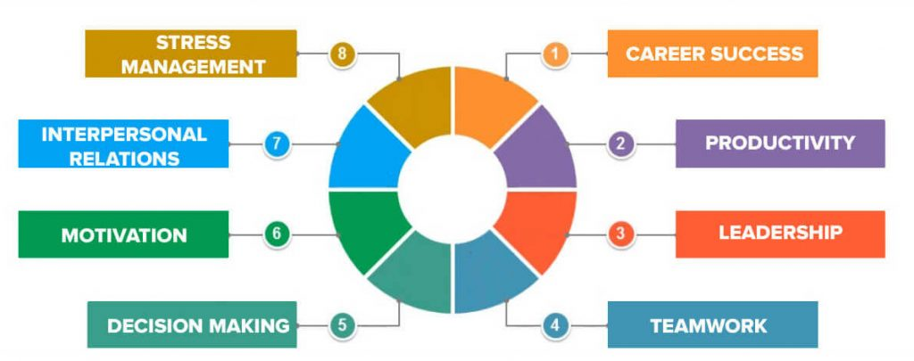

Slide 37
Importance of Attitudes
Career Success: A positive attitude of an employee will help him to think of ways to accomplish their task in a well-defined manner and achieve success i.e. get promotion or increase in compensation.
Productivity: An employee with a positive attitude tends to take more interest and responsibility and will provide better work, which in turn will improve productivity.
Leadership: Positive attitude demonstrated by leaders or employee will result in proper communication between the subordinate which will lead to efficient work.
Teamwork: A positive attitude of employees helps to appreciate each other‘s competencies and work as a team for achieving common objectives.

Slide 38
Contd.
Decision making: An employee with a positive attitude and mindset will help employees to make better decisions and avoid them to take an ambiguous decision.
Motivation: An employee with a positive attitude will always be mentally prepared to face any obstacle in a job. The moment they are successful in overcoming obstacles, they are motivated to move forward.
Interpersonal Relations: Customers prefer to make relation with someone who is positive in nature which in turn improves customer loyalty.
Stress Management: Positive attitude and thinking will reduce the stress of an employee and with reduced stress employee can take a better decision and increase their productivity which results, employees, to enjoy better health and take fewer sick leaves.

Slide 39


Slide 40
References
https://www.iedunote.com/values
https://www.iedunote.com/attitude-definition-characteristics-types
https://www.geektonight.com/what-is-attitude-meaning-functions-types-importance-components/
https://www.iedunote.com/values-attitudes-difference
https://www.slideshare.net/shrinivas1648/attitude-organisational-behaviour-60404815

